Slide 1

KNOCK-KNOCK
A deep learning powered door camera
Steven Leung
Juan Ramirez
Javed Roshan
W251 Final Project Presentation

Slide 2
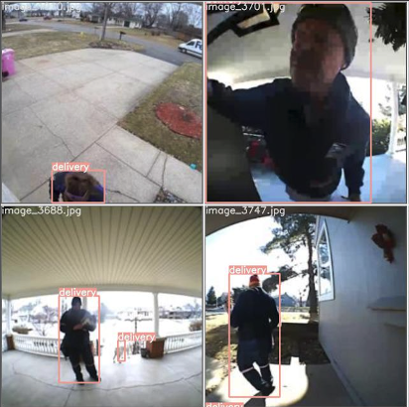
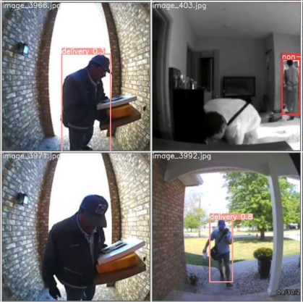
Why Knock-Knock?
The door camera market size reached $1.83B in 2020 (16% US households)¹
Knock-knock is a novel door camera that recognizes common personnel at the door and notifies user:
Facial Recognition to identify known individuals
Full body recognition to identify delivery vs non-delivery personnel
Notes:
Steve get image

Slide 3
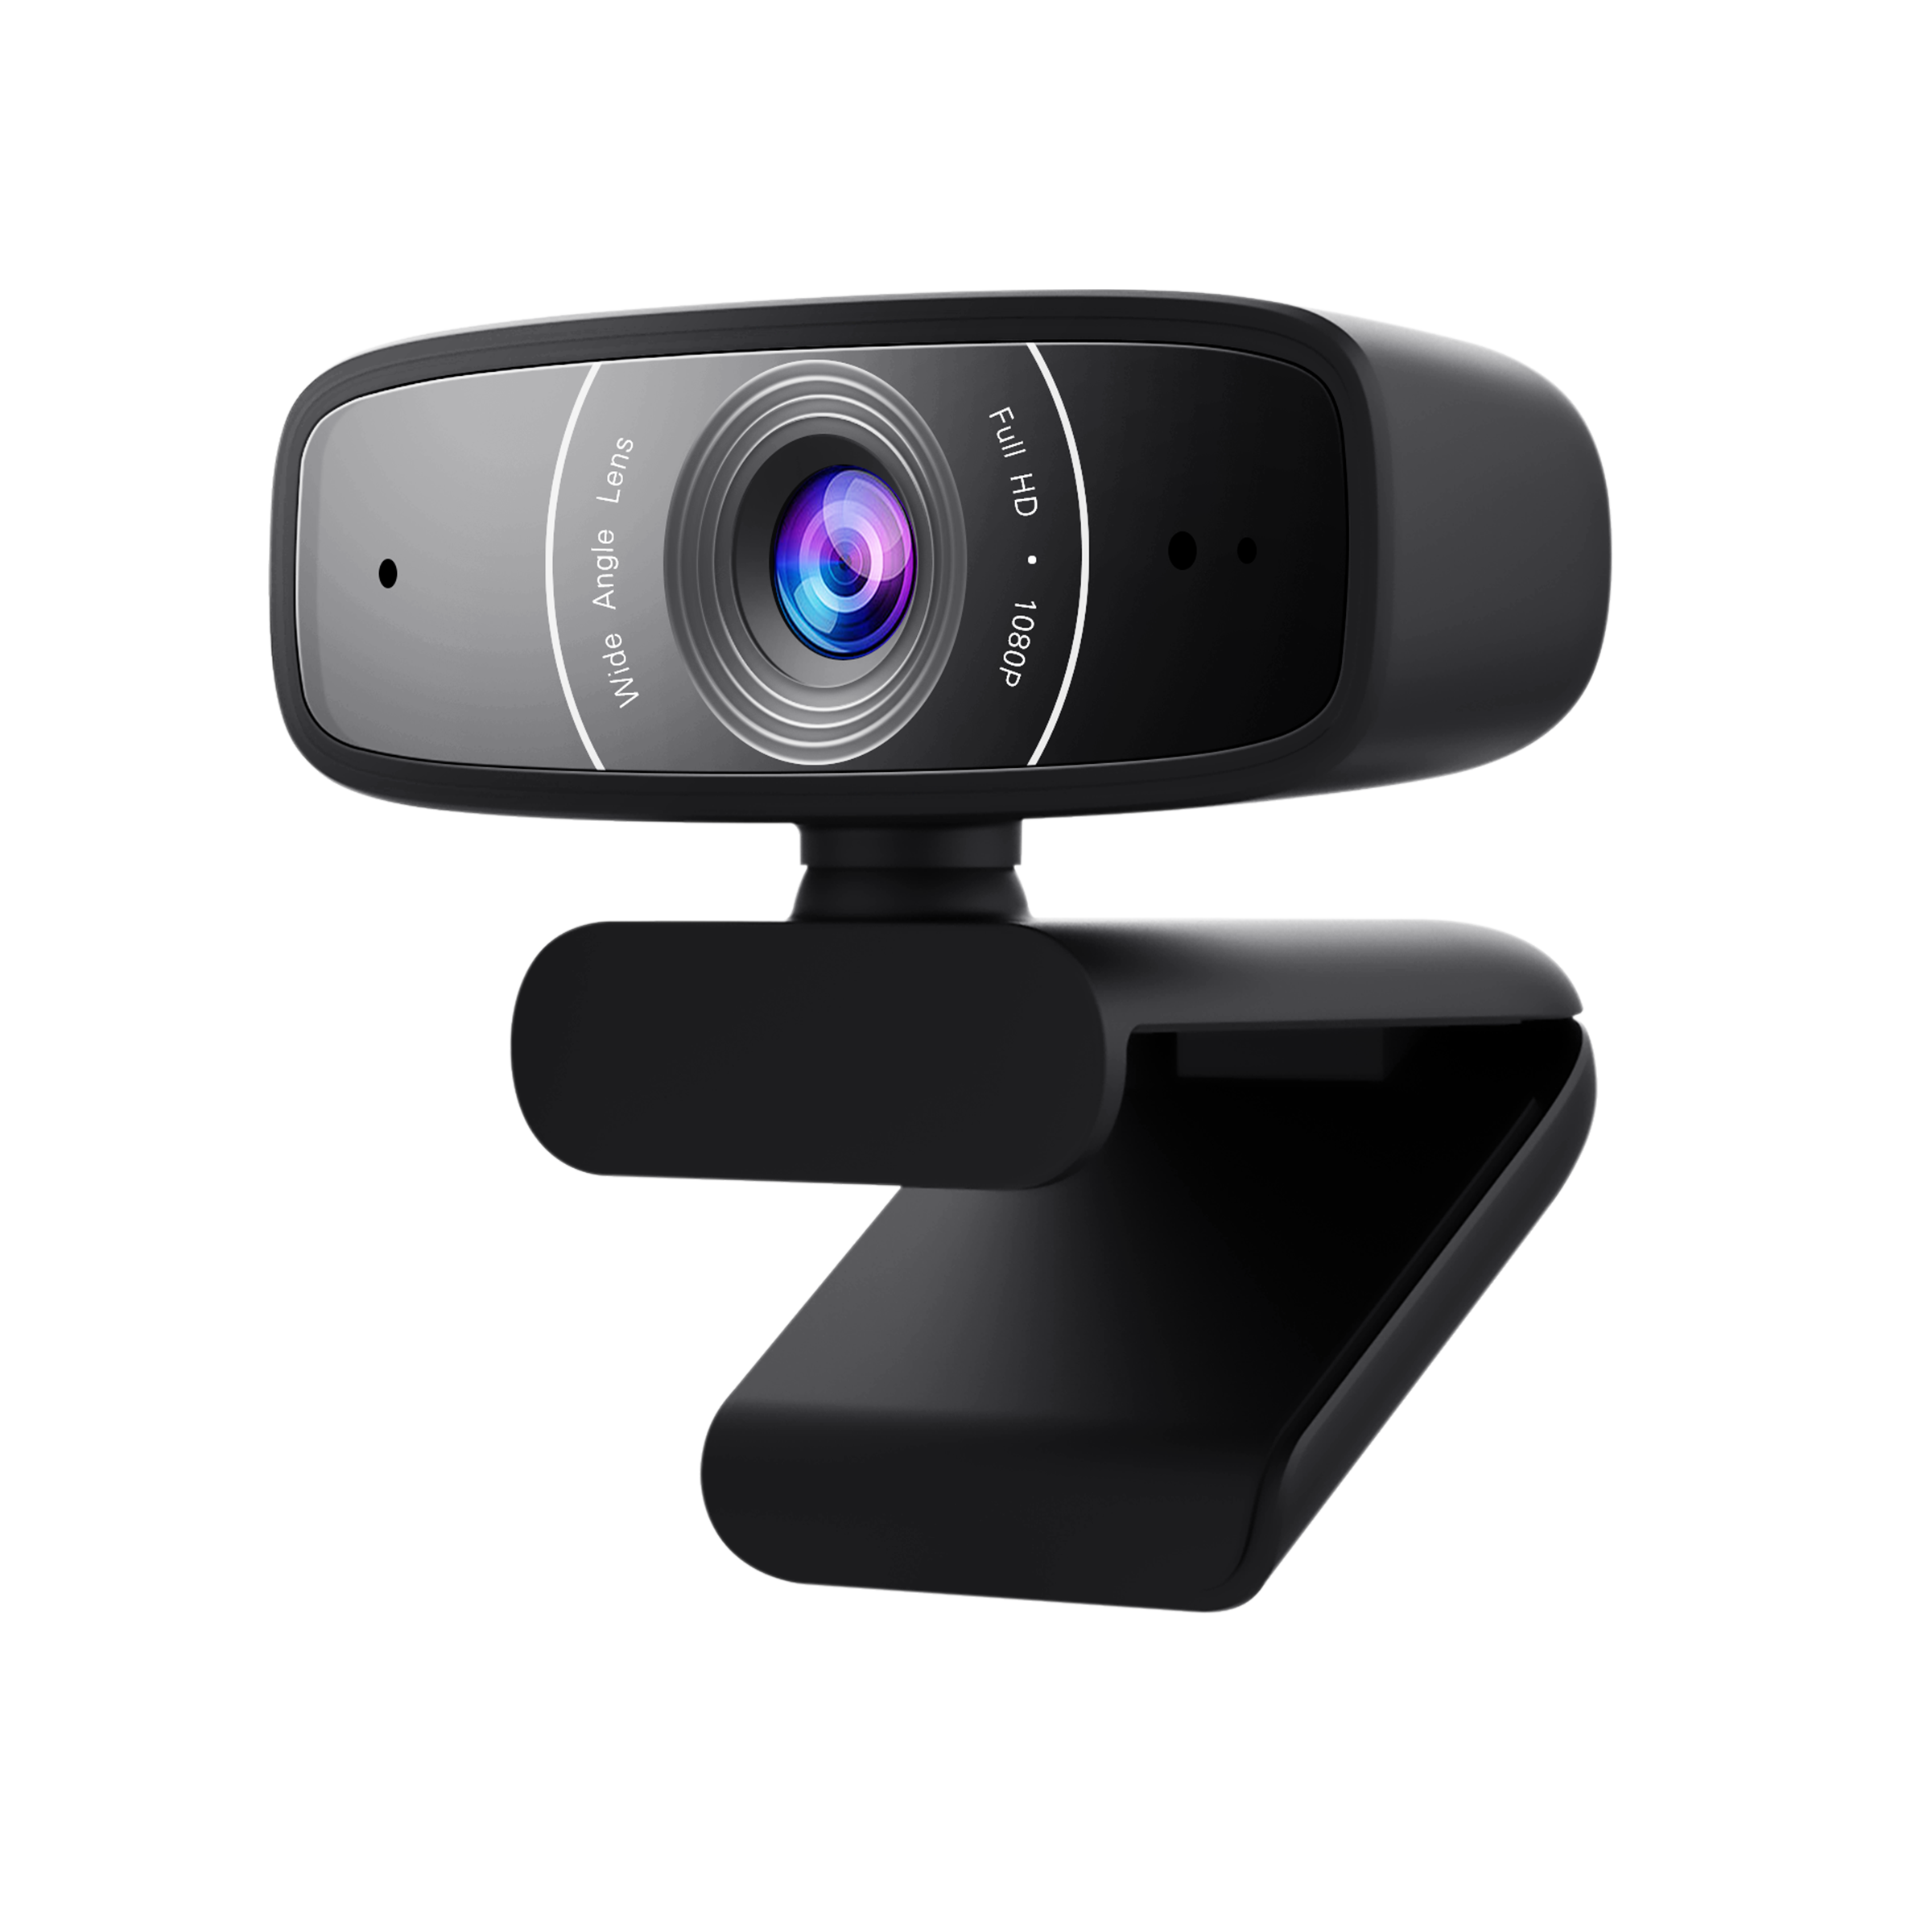
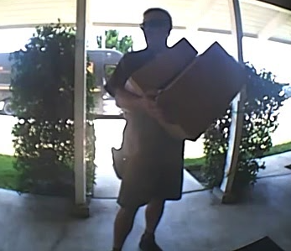
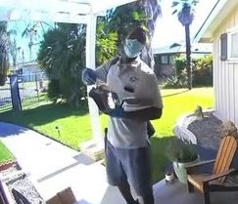
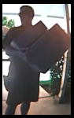

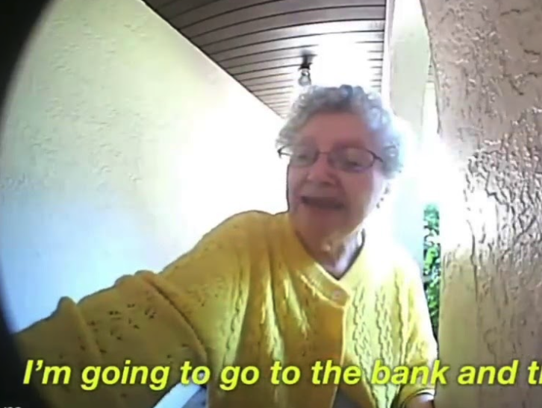
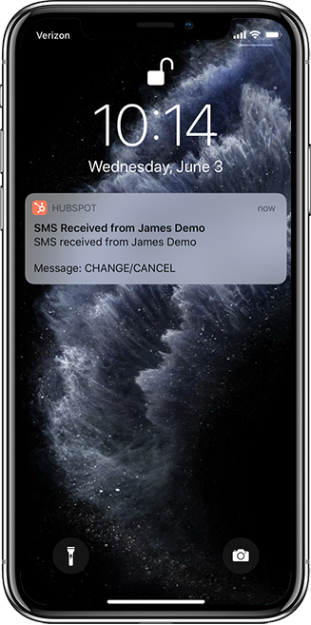
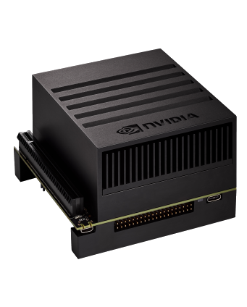

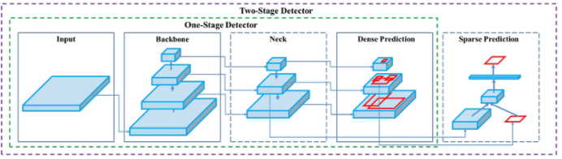
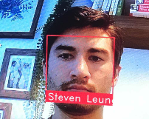
Data Pipeline
Video Stream
Image Collection Youtube to Images
Annotation Deep Lab Segmentation
Person Recognition
Fine tune Yolov5
Personnel Recognition
Jetson Xavier NX
SMS Notification
Facial Recognition
Facial Recognition
Dlib Face-Recognition

Slide 4
Automated Annotations- DeepLab Segmentation
We used search query and deeplab segmentation to automatically annotate 10k images from youtube videos
IMAGE of segmentation process here
Notes:
Juan

Slide 5
Fine Tuning Yolov5
High level of Yolov5 and cnn’s
Why YOLO?
IMAGE of CNN or Yolov5 architecture here
https://medium.com/axinc-ai/yolov5-the-latest-model-for-object-detection-b13320ec516b
Notes:
Javed

Slide 6
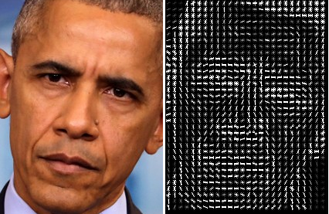
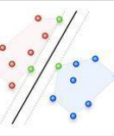
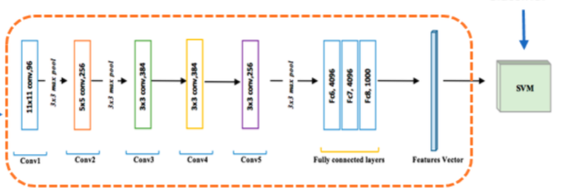
Dlib Face-Recogntion
HOG + SVM
Obama
Dlib is a popular deep learning library written in C++ with python api.
Face_recognition is a one-shot model utilizing Histogram Oriented Grandient (HOG) + Support Vector Machine (SVM) model or CNN based model
Performed at 99.38% on Labeled Faces in the Wild benchmark.
HOG
SVM
CNN
Obama
Notes:
Steven
HOG uses gradient direction of each pixel, groups them into small groups called cells. Take a histogram of each cell to reduce noise and aggregate direction over the group. Doing this for all cells give an overall structure of the image.
SVM as a classifier the seperates labels based on hyperplane
CNN has now been shown to do much of the work of HOGs and are now replacing them but still perform a bit slower.
For our use case, we chose the HOG-SVM because did not see significant difference in performance with CNN’s but may adjust with more difficult inference environment.

Slide 7
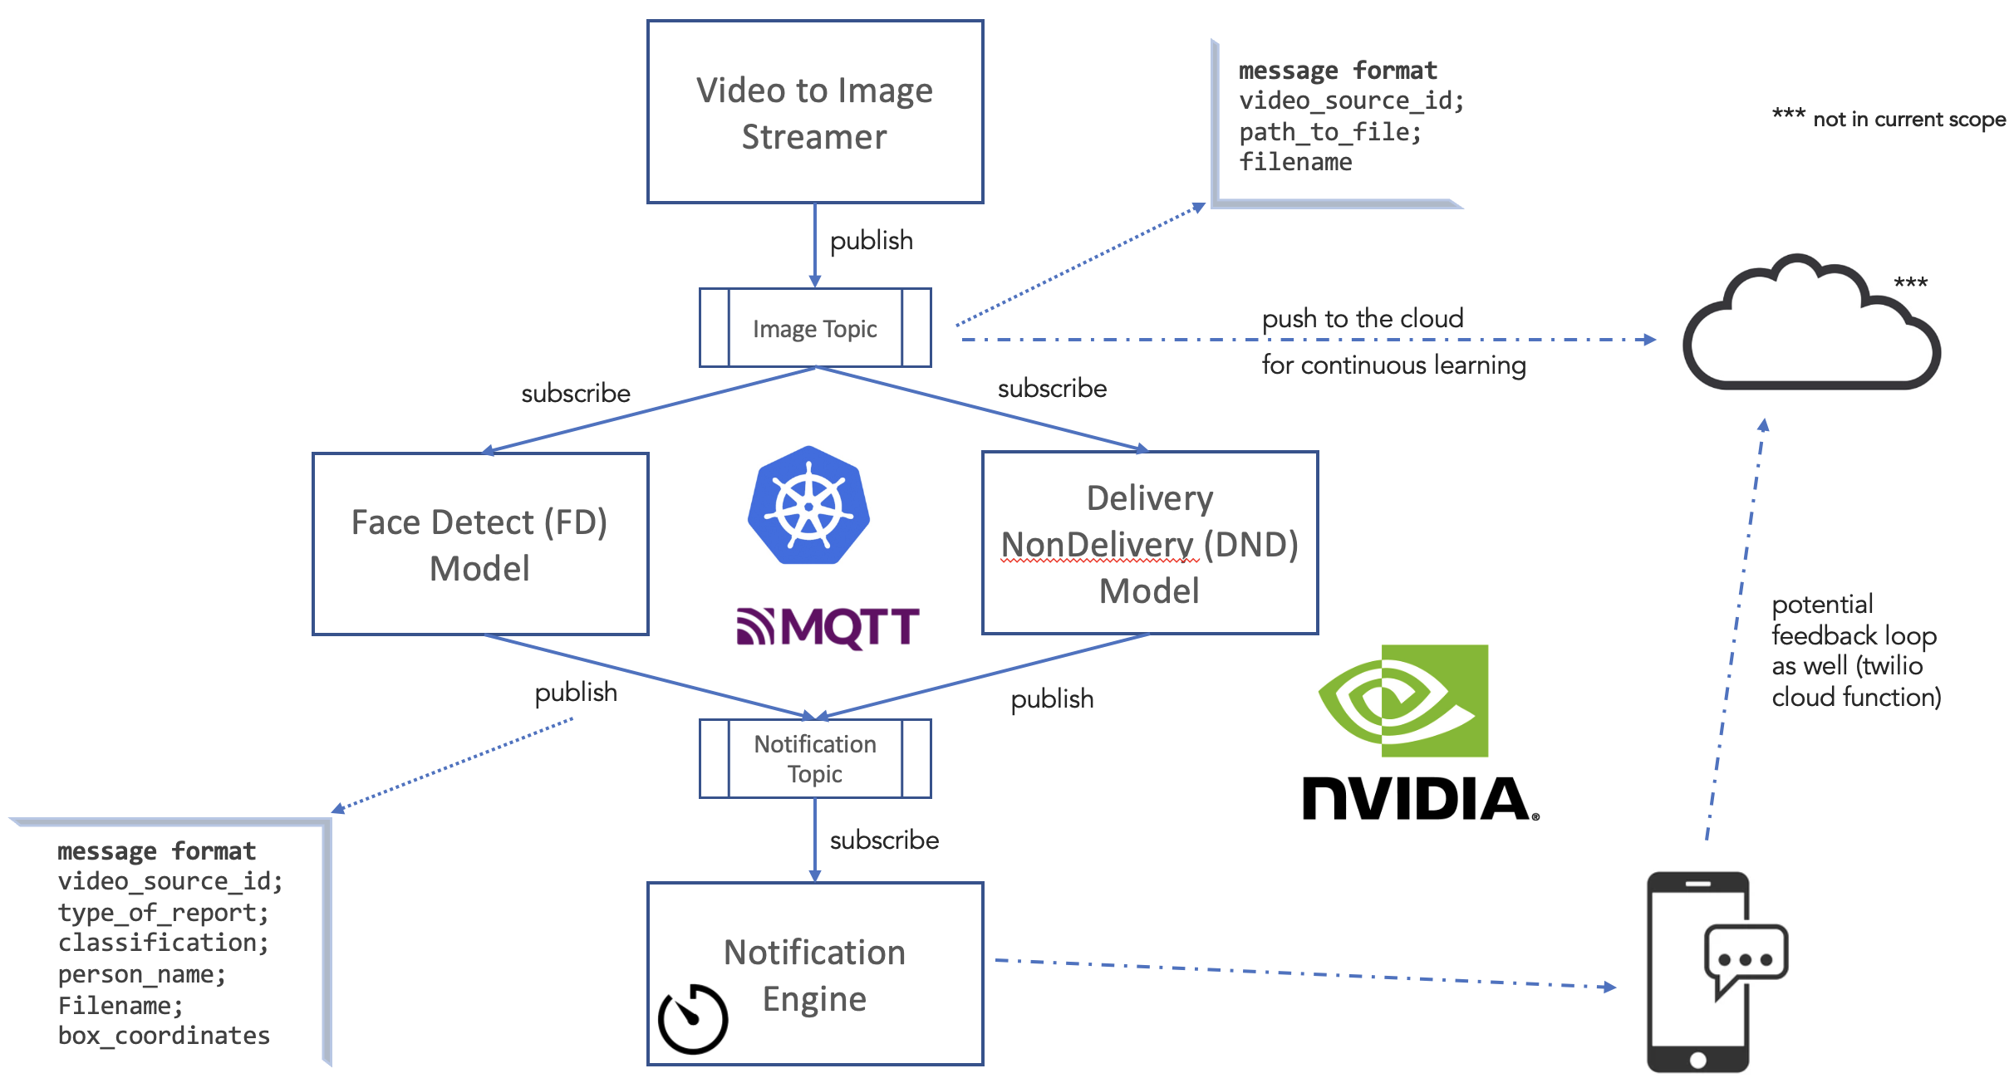
Inference Side
Notes:
Javed

Slide 8
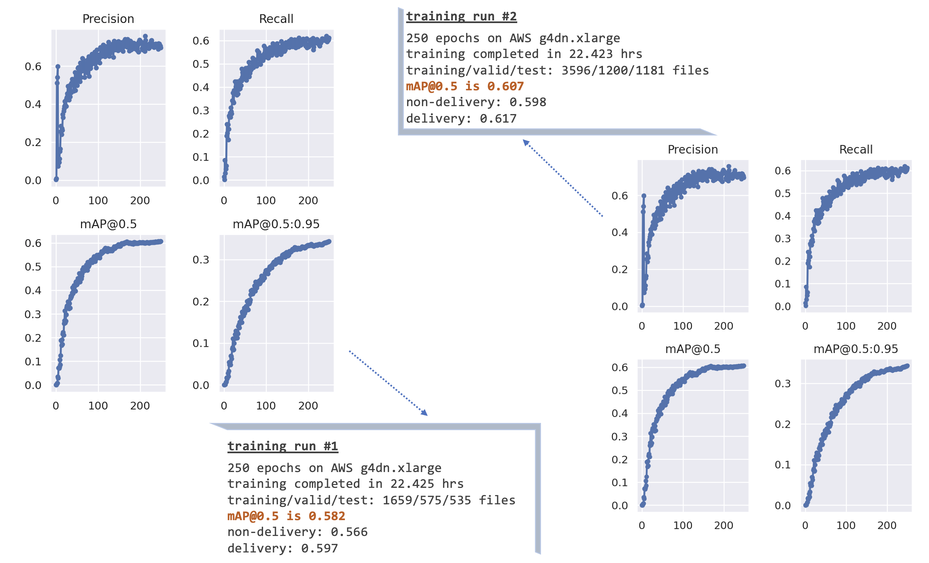
Model Performance
Notes:
Javed

Slide 9
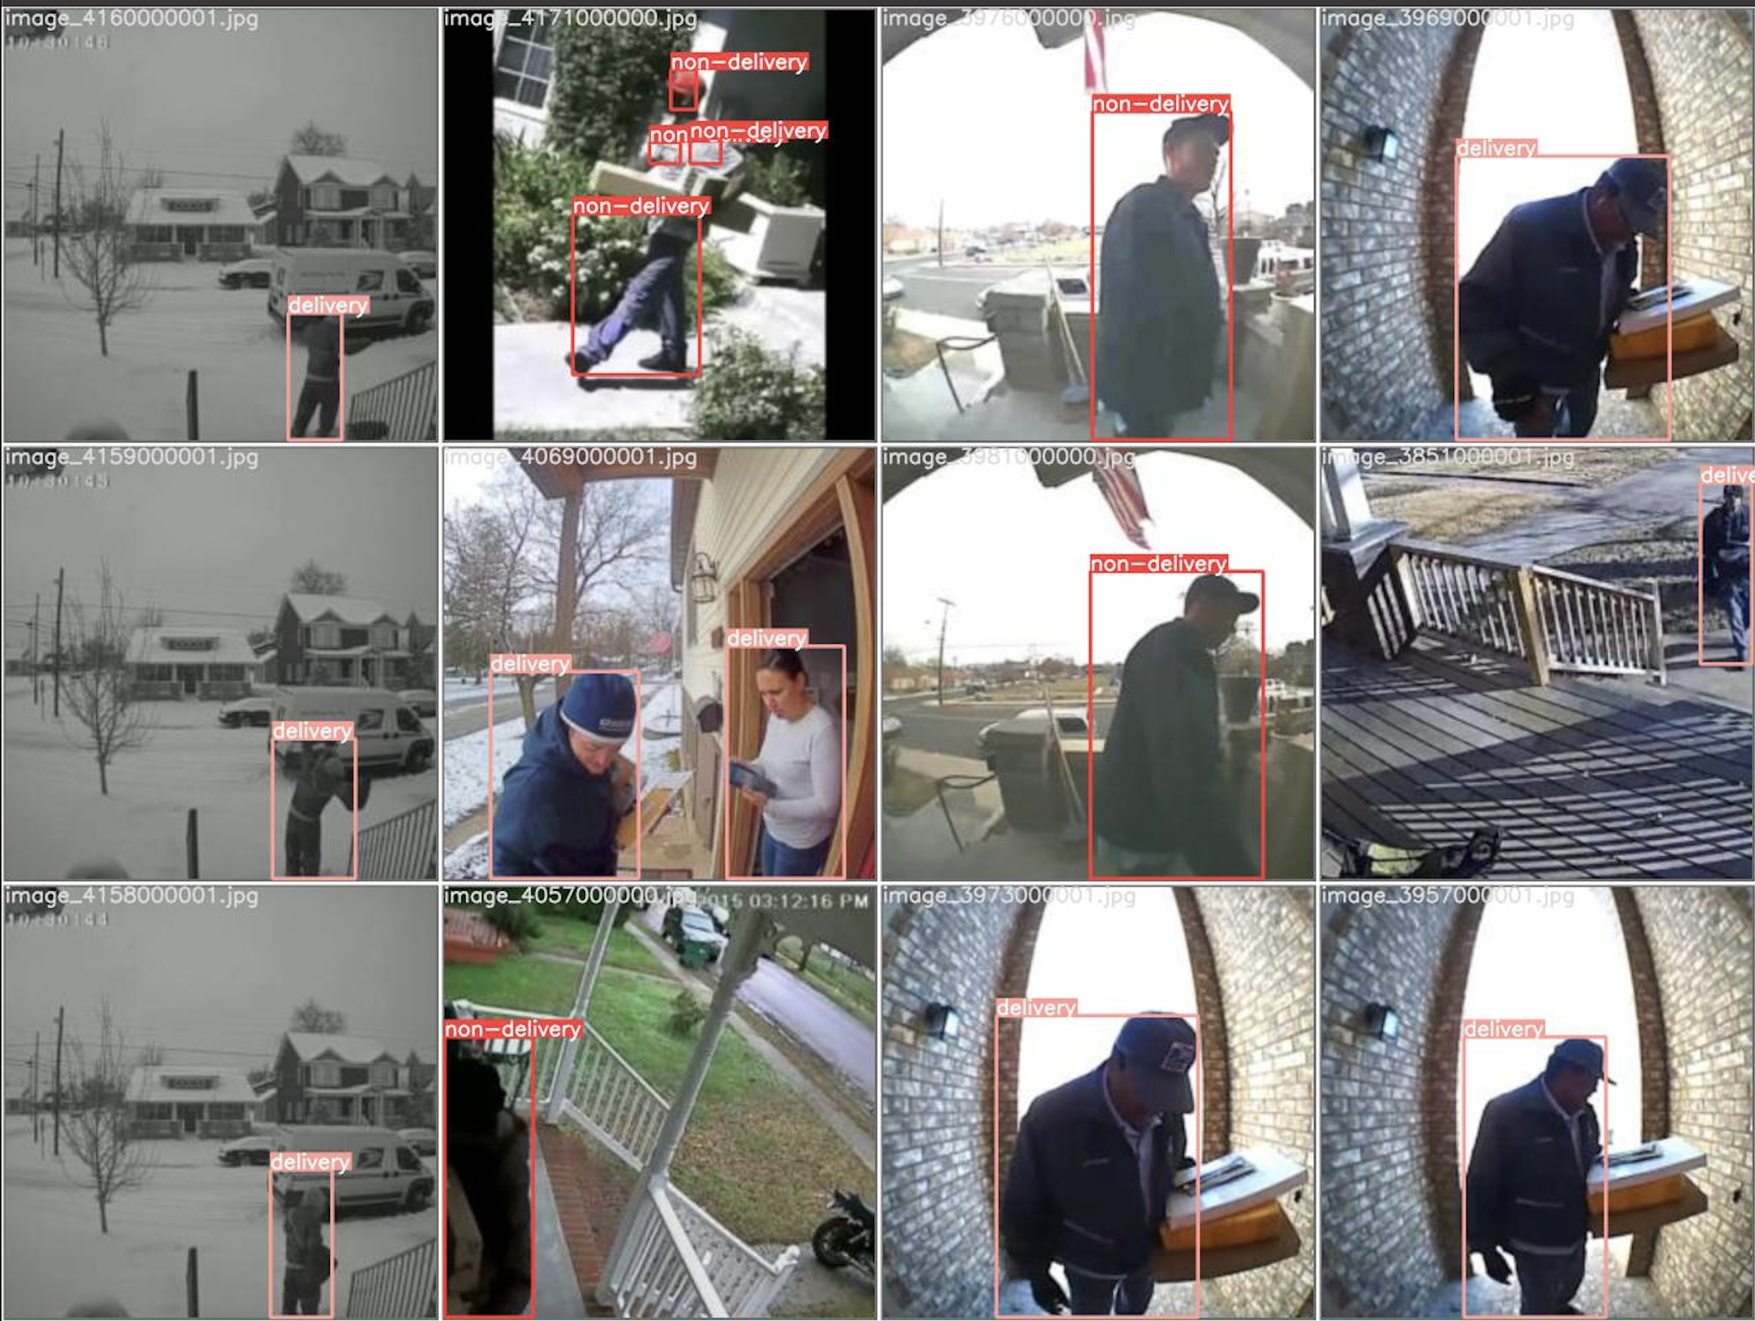
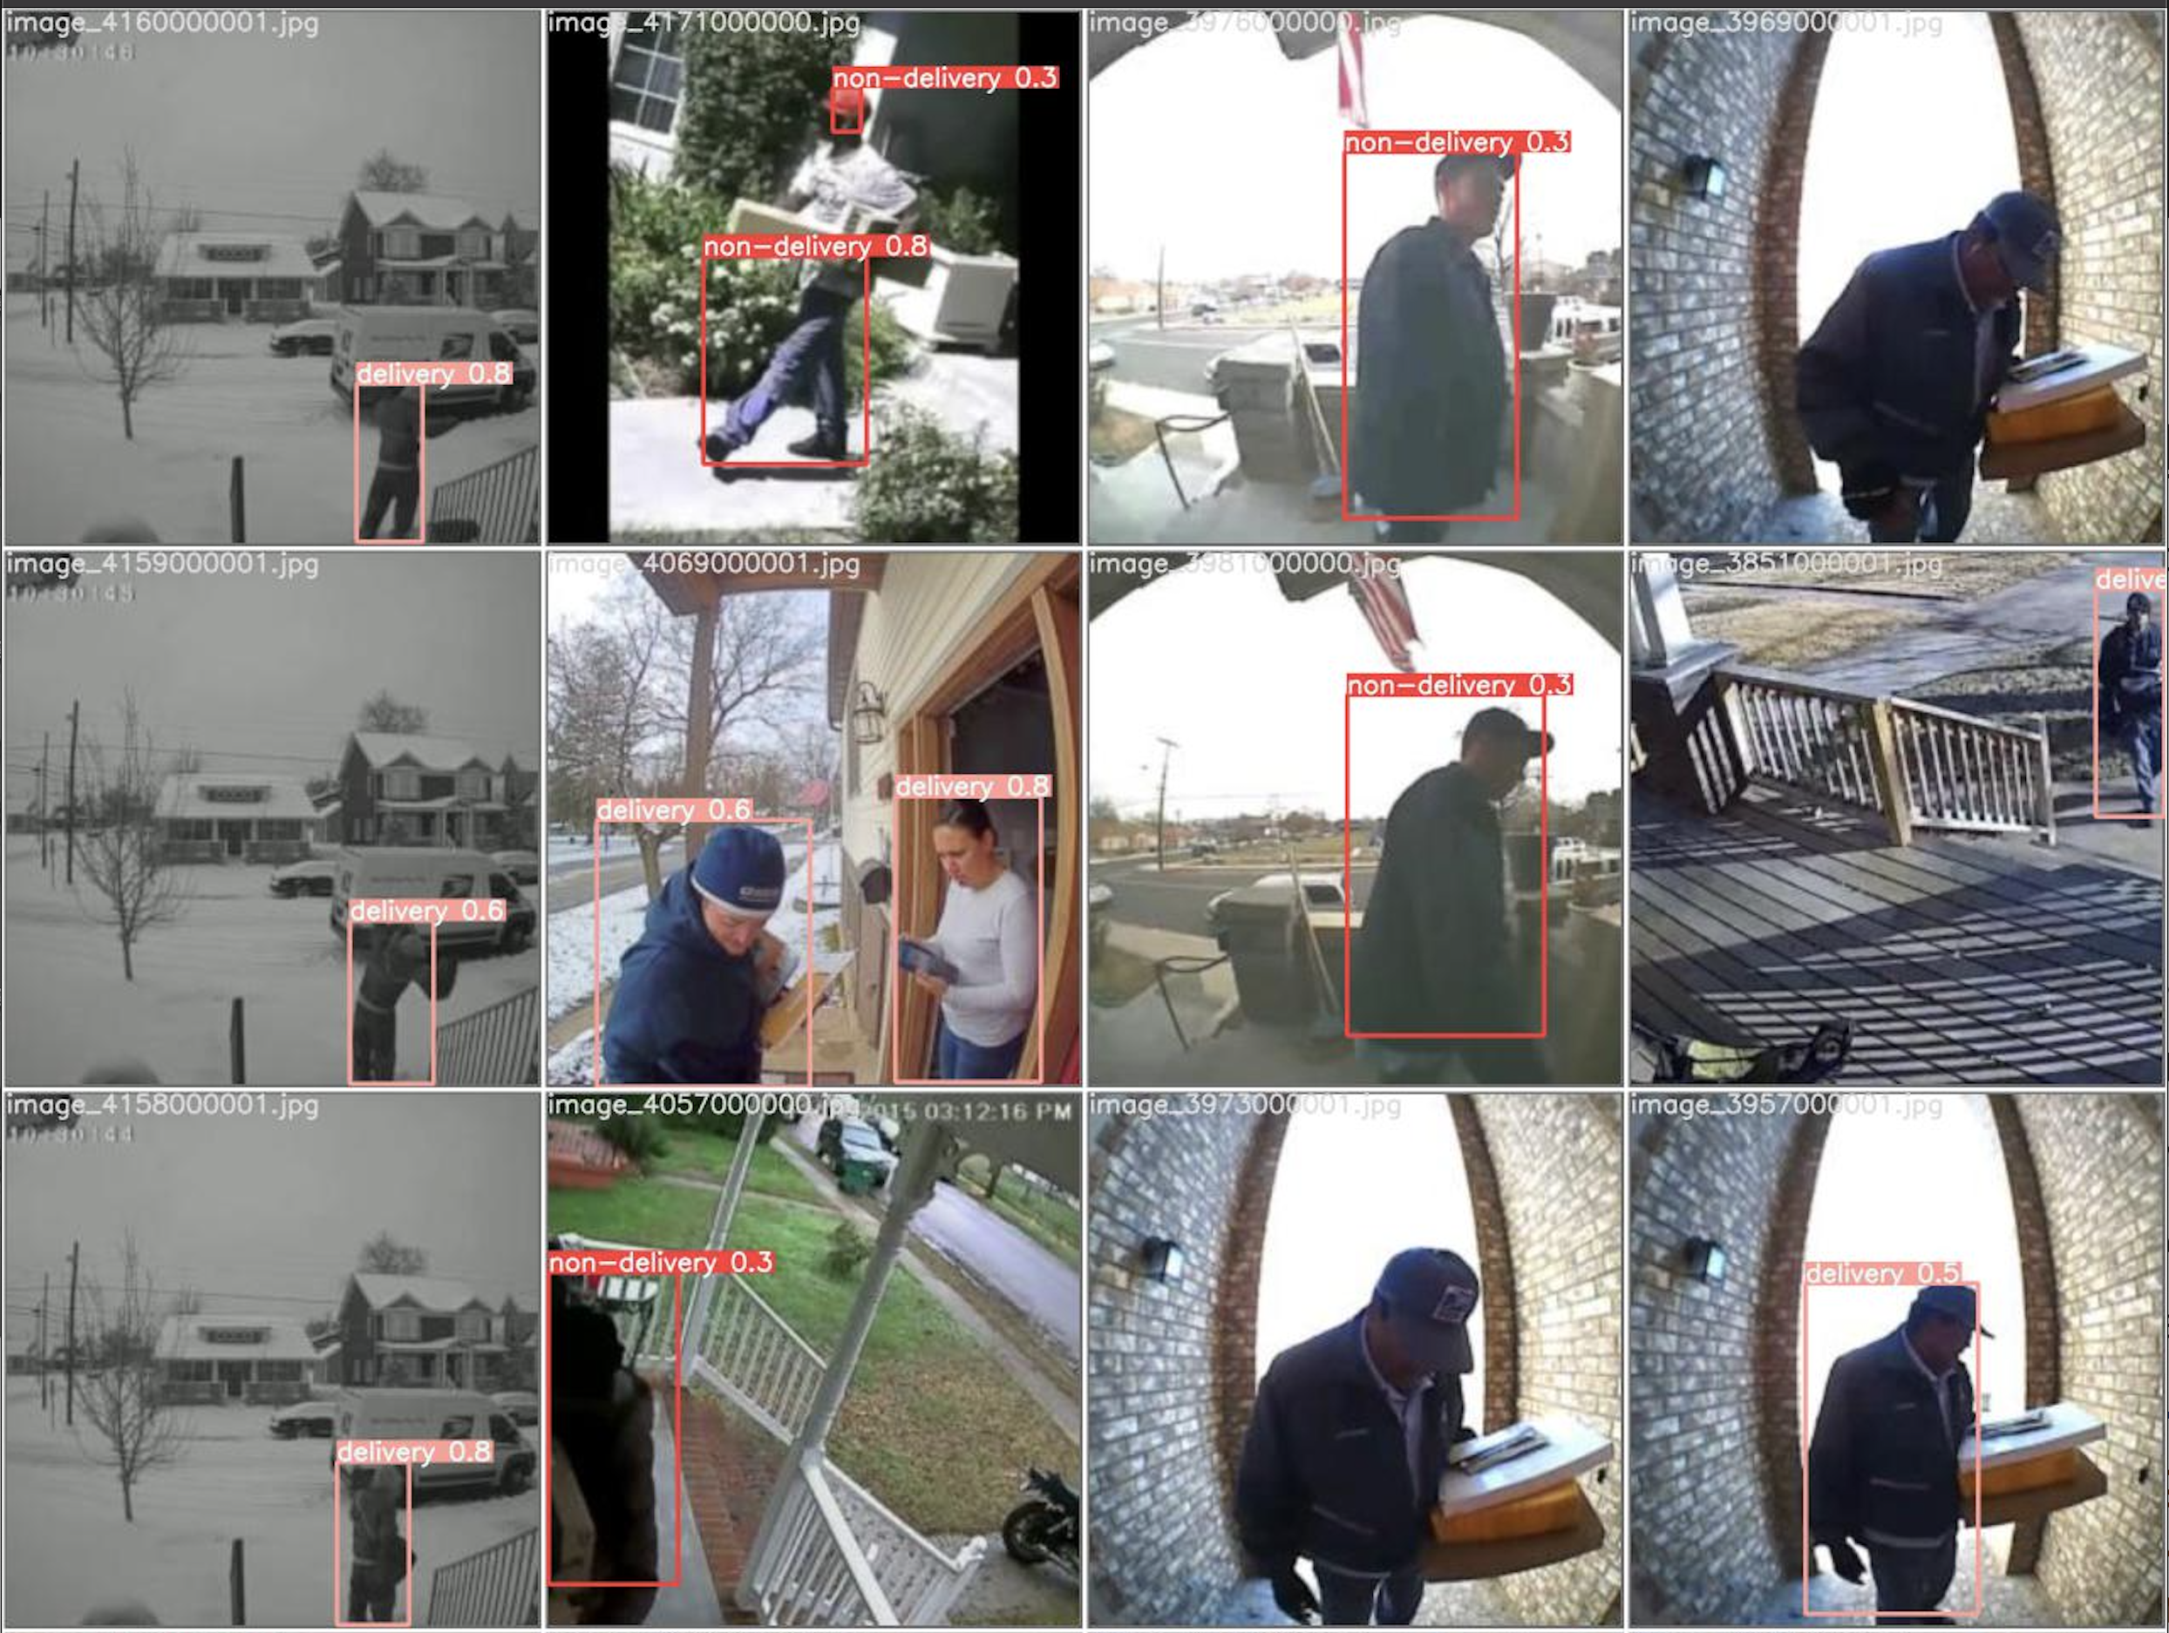
Model Performance
Labelled
Predicted
Notes:
Javed

Slide 10
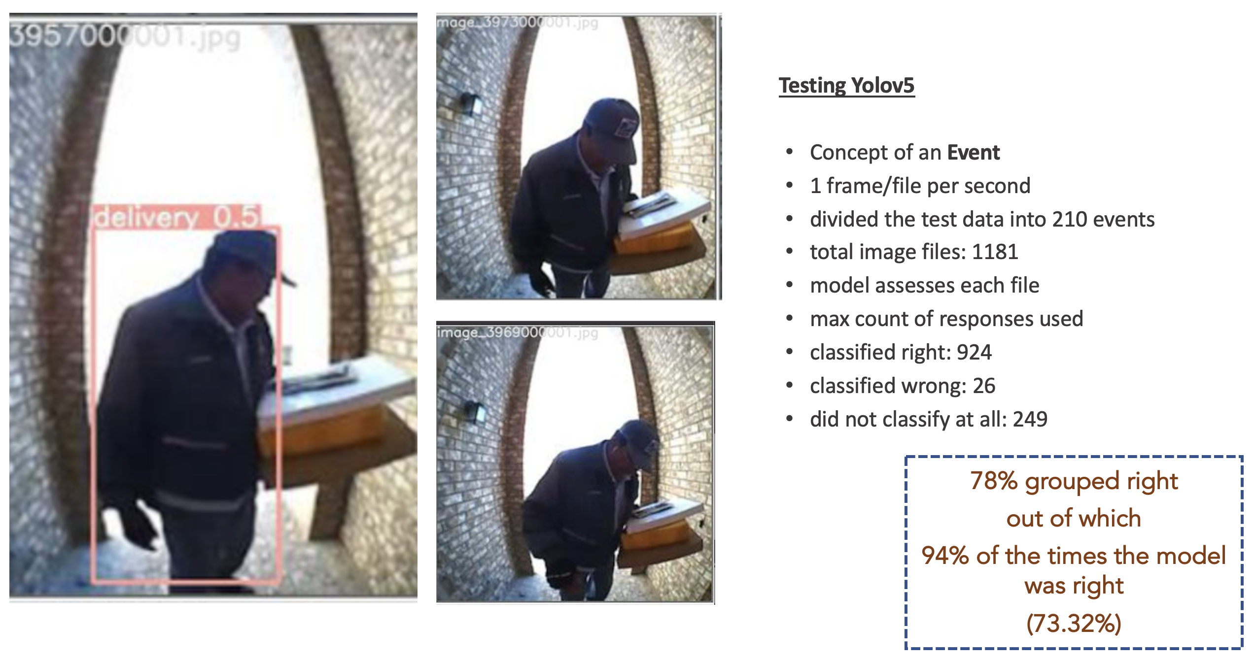
Testing w/Yolov5
Notes:
Javed

Slide 11
Knock-Knock in Action
Demo video here
Notes:
Steven

Slide 12
Challenges
Getting good data and tags
Timing and lag
Notification logic
Containers and Kubernetes (getting right environments for each component)
Events in testing
Notes:
Juan

Slide 13
Next Steps
Continuous Training and Evaluation
Archiving faces to recognition repeat visitors
Other types of personnel
Include vehicle
Package thieves
Combining with amazon schedule
Summarization of actions at the door
Notes:
Steven

Slide 14
To do’s (remove slide)
High level: what it is, why it matters
Model Diagram
Data collection, segmentation
Papers to reference
Details on Yolo v5, face rec model
Training details: metrics (compare to others)
Papers to ref
Jetson side diagram
Demo
Challenges
Next Steps

Slide 15
Sources
https://www.grandviewresearch.com/industry-analysis/doorbell-camera-market
https://www.cnet.com/home/security/best-facial-recognition-security-cameras/
Deep Lab Segmentation https://arxiv.org/pdf/1606.00915.pdf
Yolov5 https://zenodo.org/record/4679653#.YQlL01NKhqsDlib
face rec https://face-recognition.readthedocs.io/en/latest/readme.html

Slide 16
Fonts & colors used
This presentation has been made using the following fonts:
Share Tech
(https://fonts.google.com/specimen/Share+Tech)
Maven Pro
(https://fonts.google.com/specimen/Maven+Pro)
#002845
#e898ac
#00cfcc
#ff9973

